Slide 1
Increasing importance of North American sourced moisture for the Arctic summertime water vapor feedback
Ian Baxter^{1,2}, Qinghua Ding¹, Hailong Wang²,
Thomas Ballinger³, & Marika Holland⁴
¹Department of Geography, University of California Santa Barbara, CA
²Pacific Northwest National Laboratory, Richland, WA
³International Arctic Research Center, University of Alaska Fairbanks, Fairbanks, AK
⁴National Center for Atmospheric Research, Boulder, CO
CESM Polar Climate Modeling Working Group

Slide 2
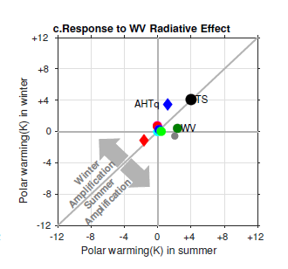
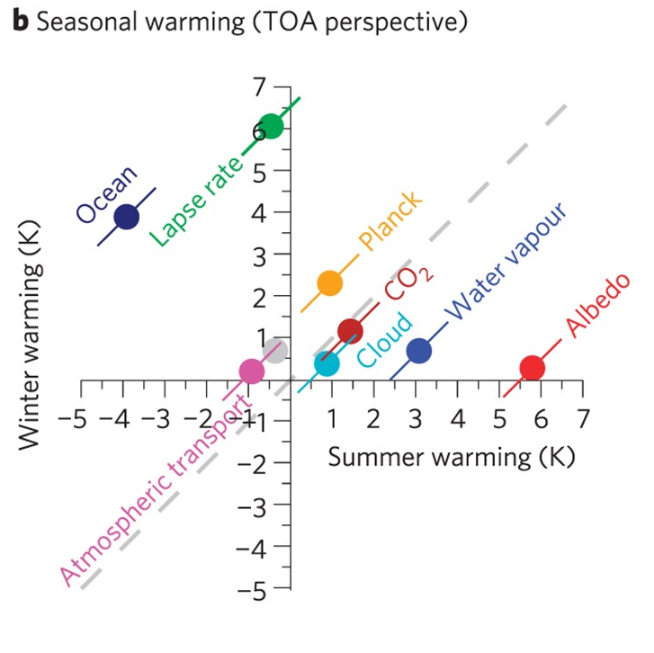
Motivation: Contribution of water vapor to summer Arctic warming
Pithan & Mauritsen (2014)
Chung & Feldl (2023)
Rate of Polar Amplification set by summertime warming (albedo + WV)
Source of this water vapor (WV)?

Slide 3
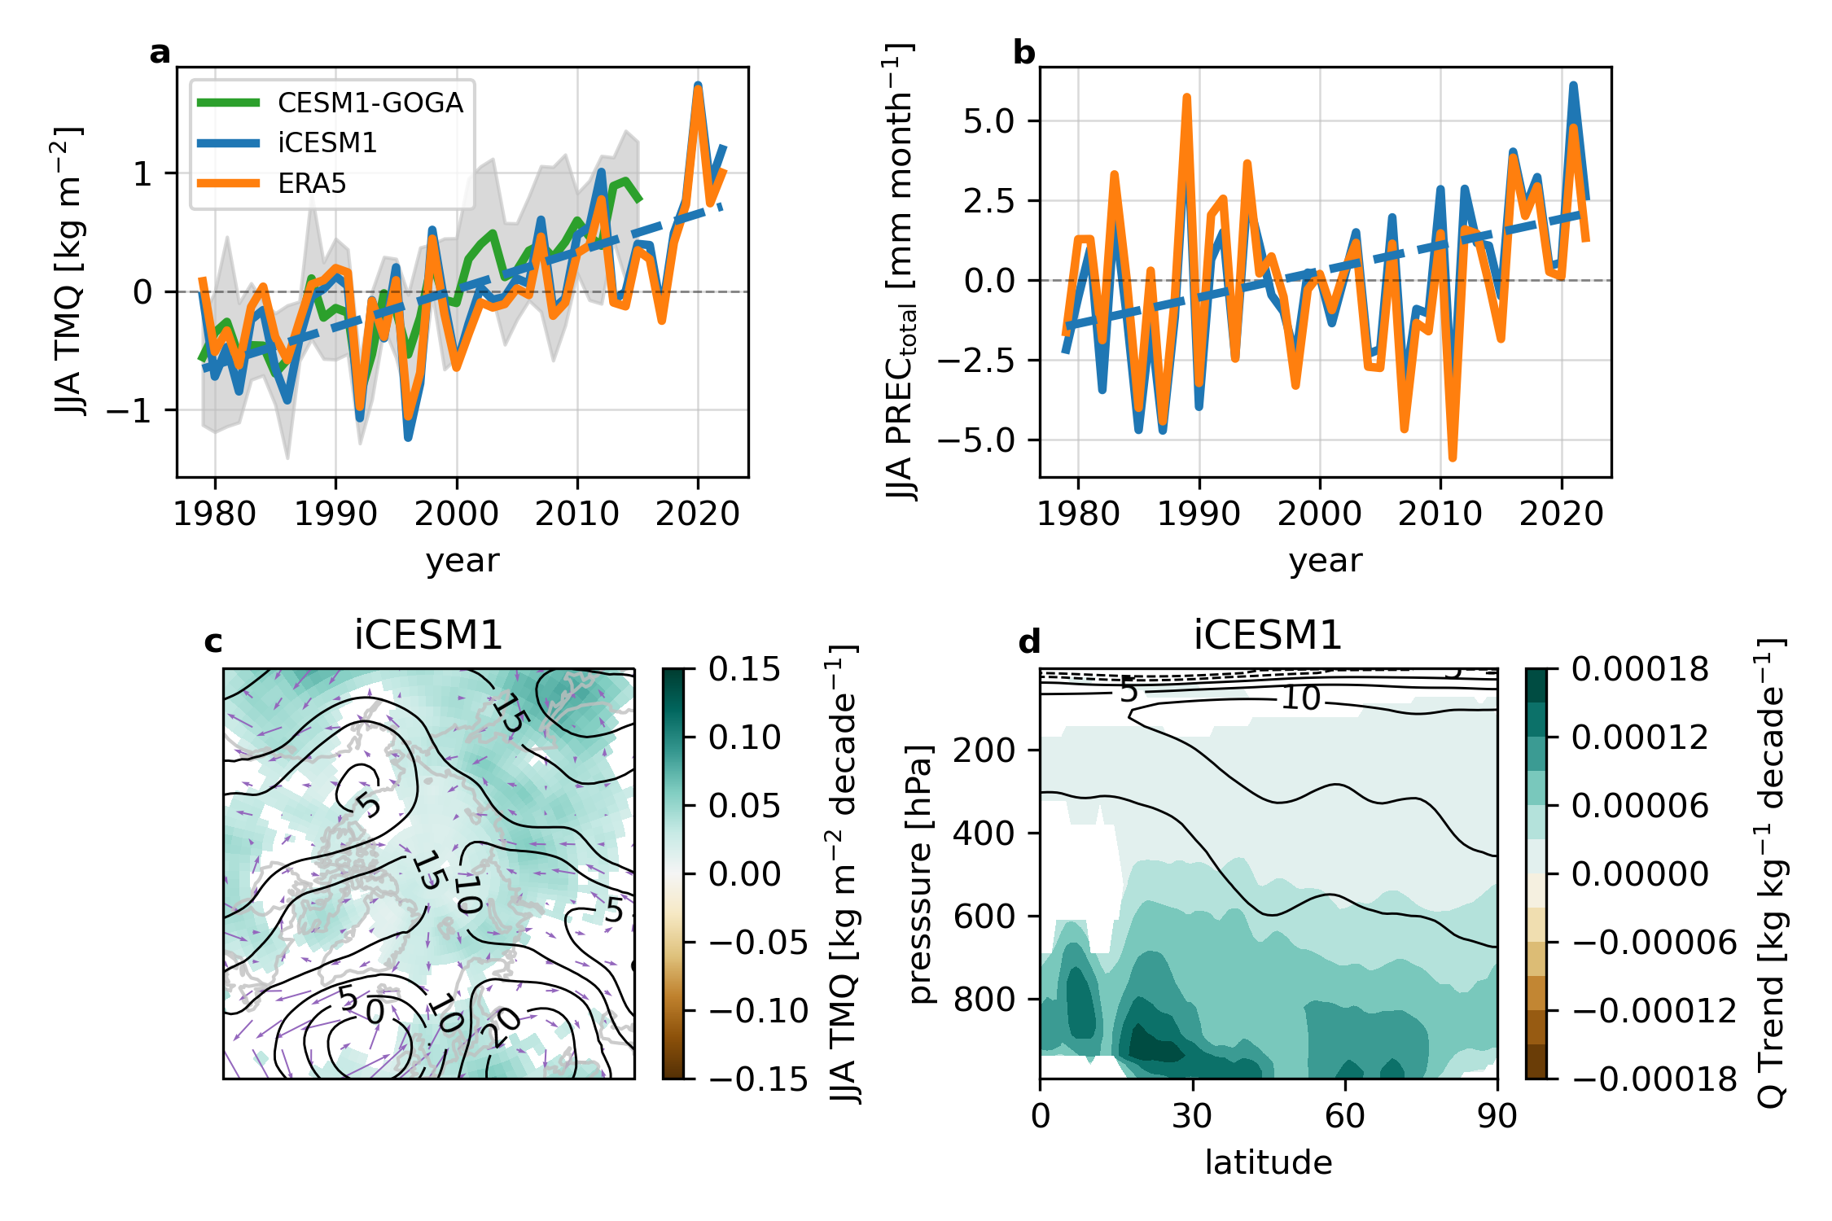
Experiment Design
Moisture tagging (isotope-enabled CESM1, iCESM1)
8 regions (based on land/ocean)
54 regions (based on lat,lon)
Singh et al. (2016, 2017)
Harrington et al. (2021)
Nudging (ERA5)
u, v, T
Fixed GHG concentrations
Goals:
Replicate ERA5 Arctic hydrological cycle
Characterize regional contributions to “observed” summer WV feedback

Slide 4
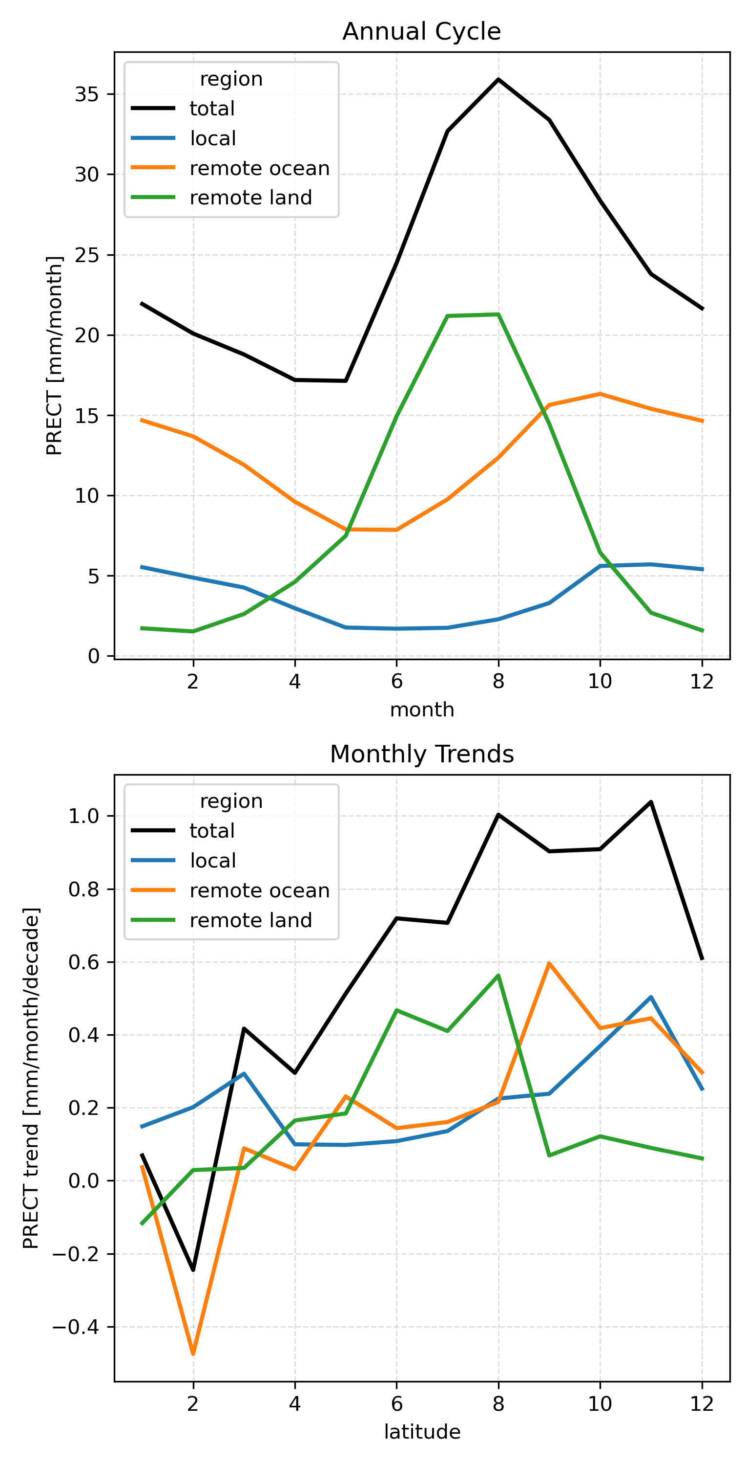
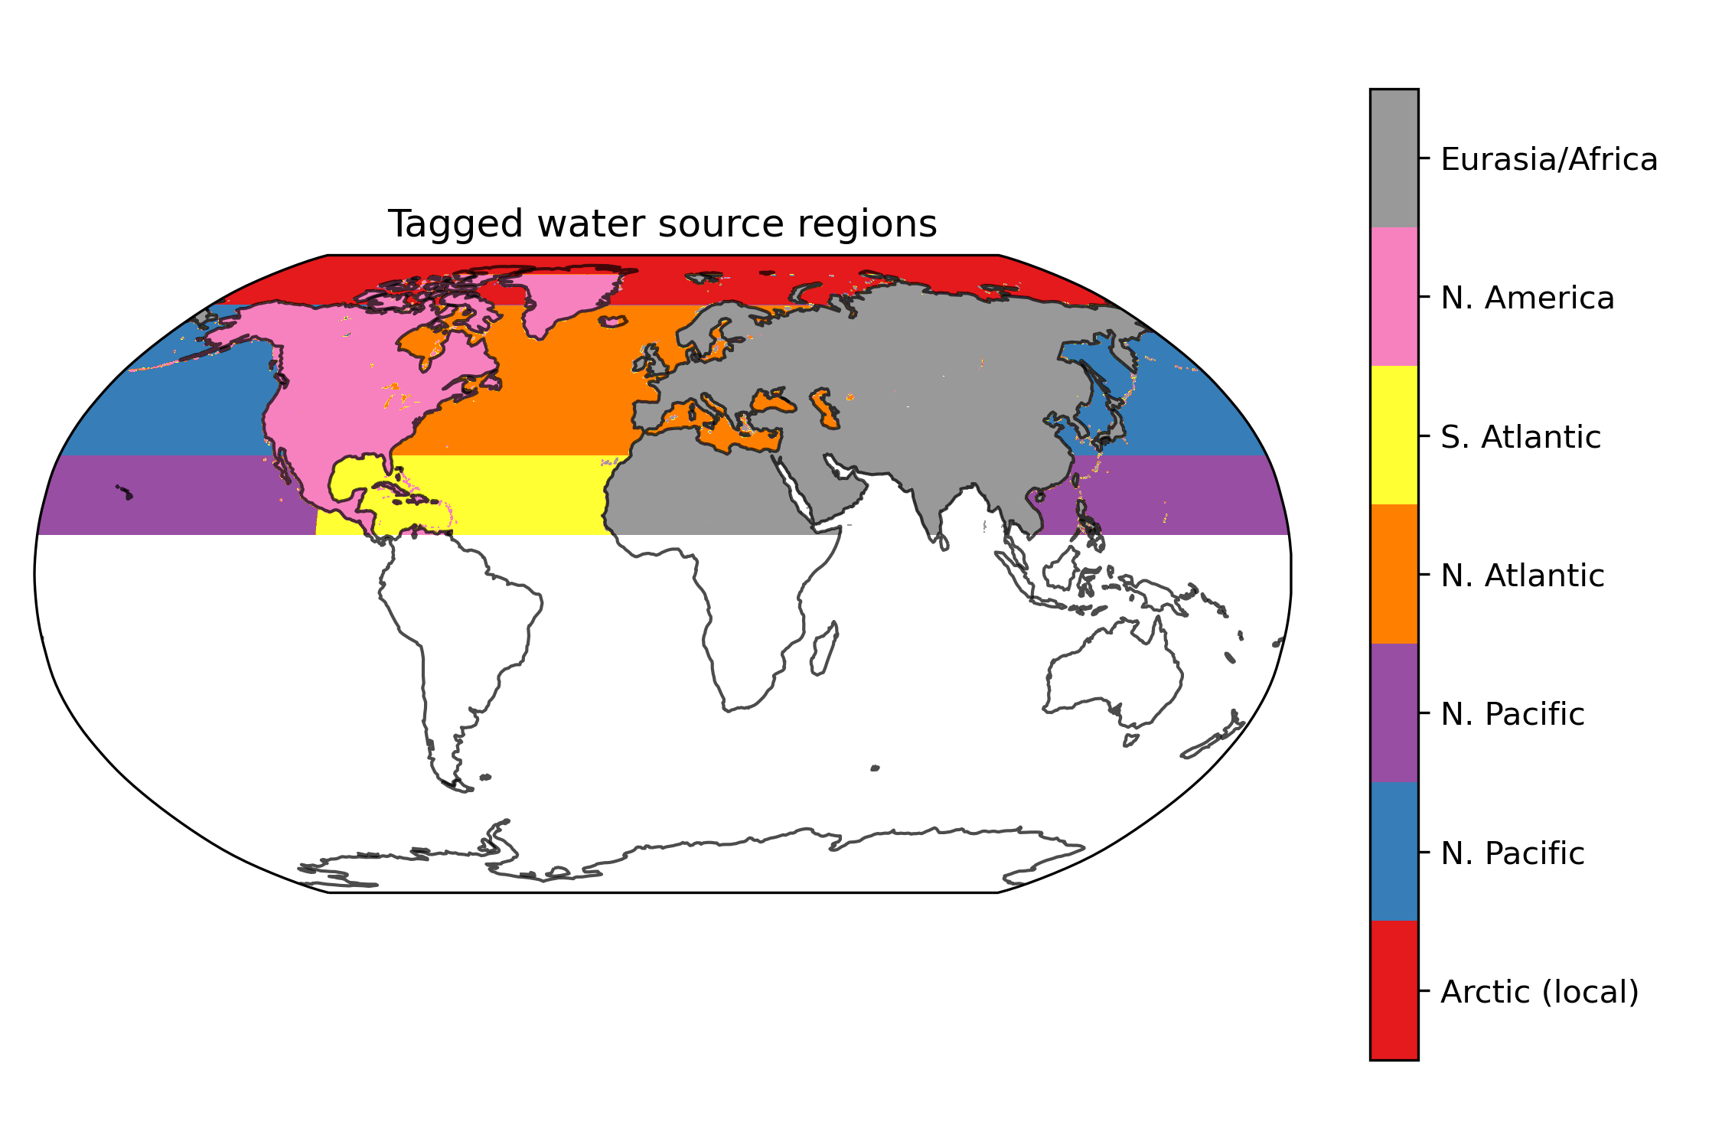
Annual Cycle vs. Trends
Land sources dominate in summer (~62%)
Singh et al (2016, 2017) – 80% remote
Harrington et al. (2021) – 56% land
Fearon et al. (2021) – 32% land
Local and remote ocean sources (North Atlantic) dominate in other seasons
Relative changes favor local sources in summer and remote ocean in other seasons
Notes:
63% from Eurasia vs. 34% from North America
Fix trends to be contribution to total precipitation trends

Slide 5
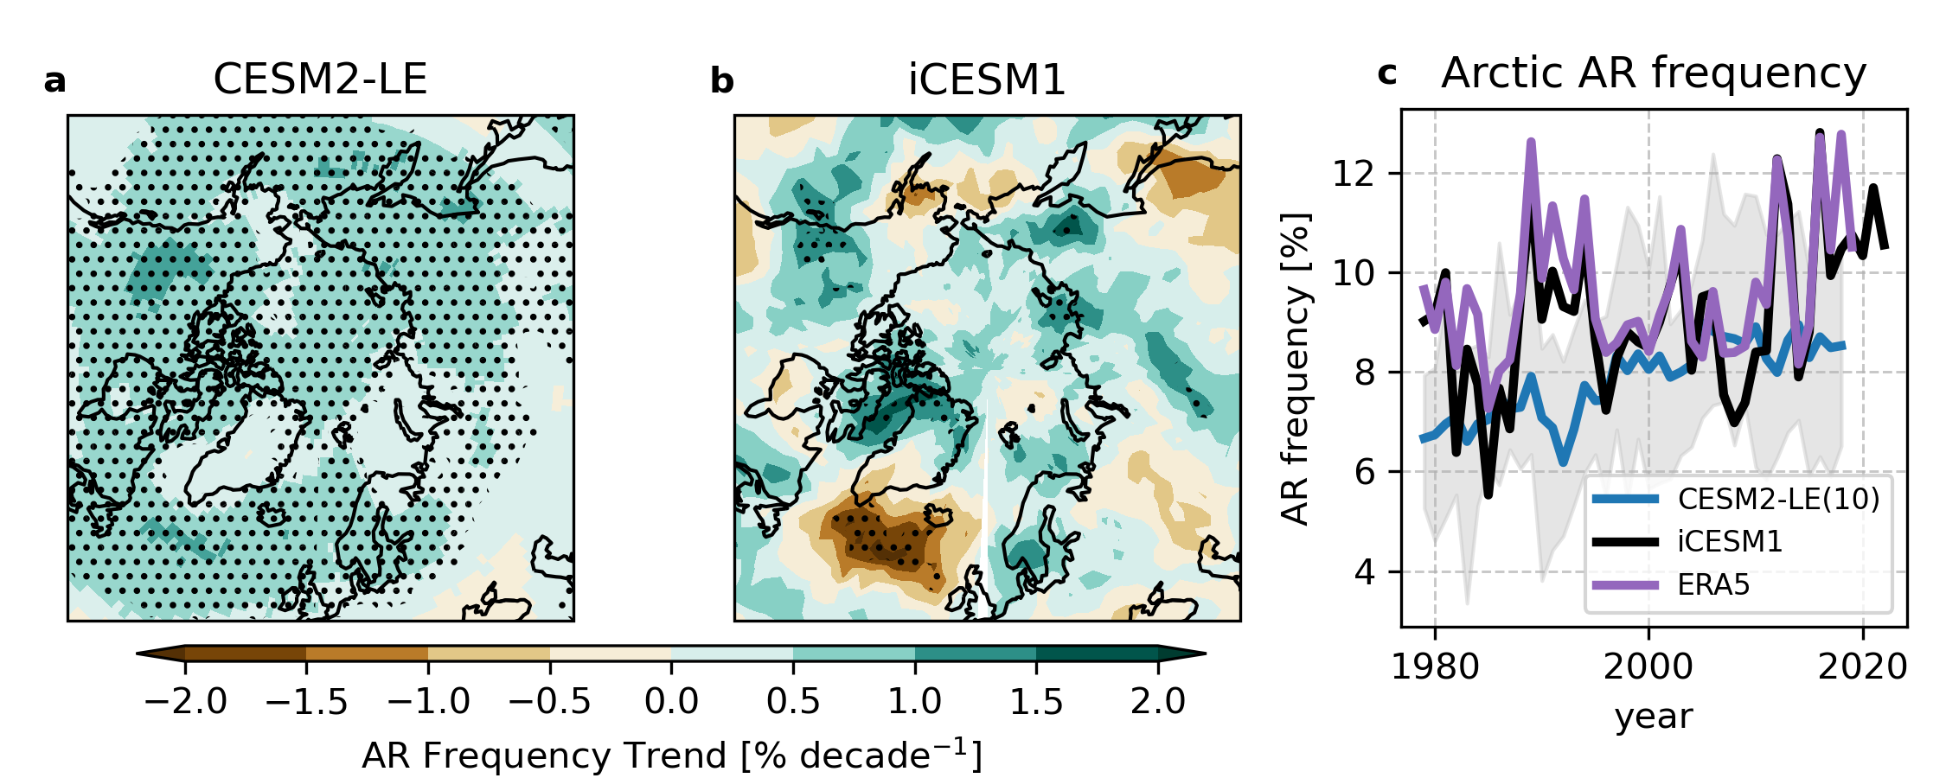
Increasing atmospheric rivers (AR) frequency from major pathways
4 Major pathways
80-92% of transport trends due to changes in ARs

Slide 6
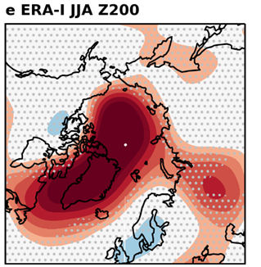
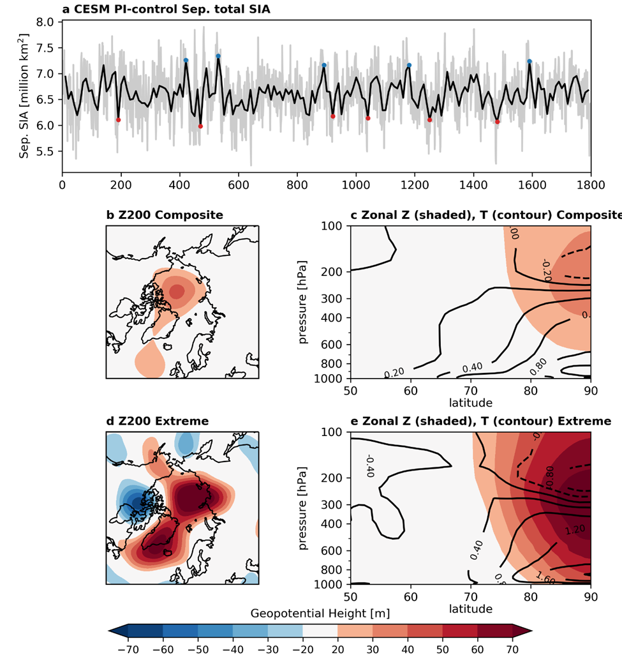
The CESM struggles to capture anticyclonic circulation over Greenland
Z200 = 200 hPa geopotential height
From Baxter & Ding Journal of Climate (2022)

Slide 7
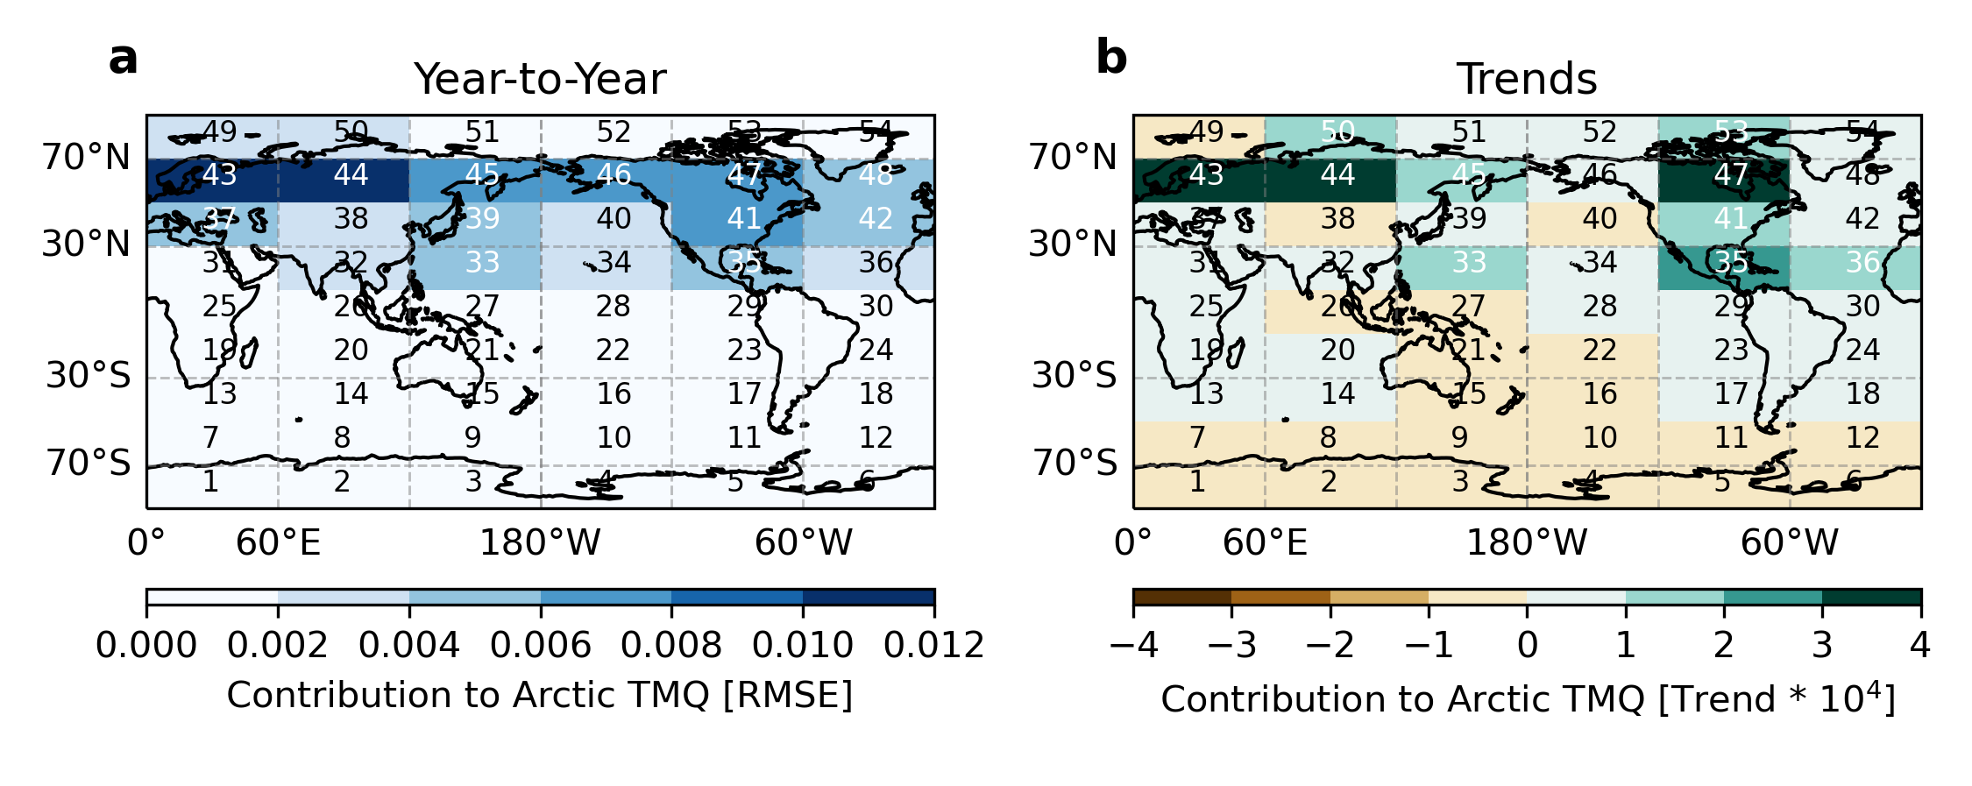
Remote sources of summer Arctic water vapor trends
50-70N land sources dominate trends (65% from land)

Slide 8
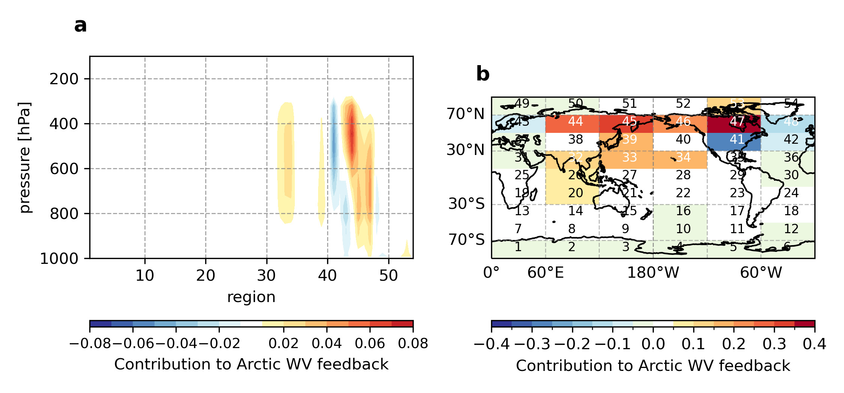
Arctic WV feedback dominated by remote land moisture sources
92% contribution from remote sources (~1/4 from northeastern Canada)

Slide 9
Vertical Structure of Transport
Uniform transport produces most efficient radiative impact
Weak local impact confined to surface (8%)

Slide 10
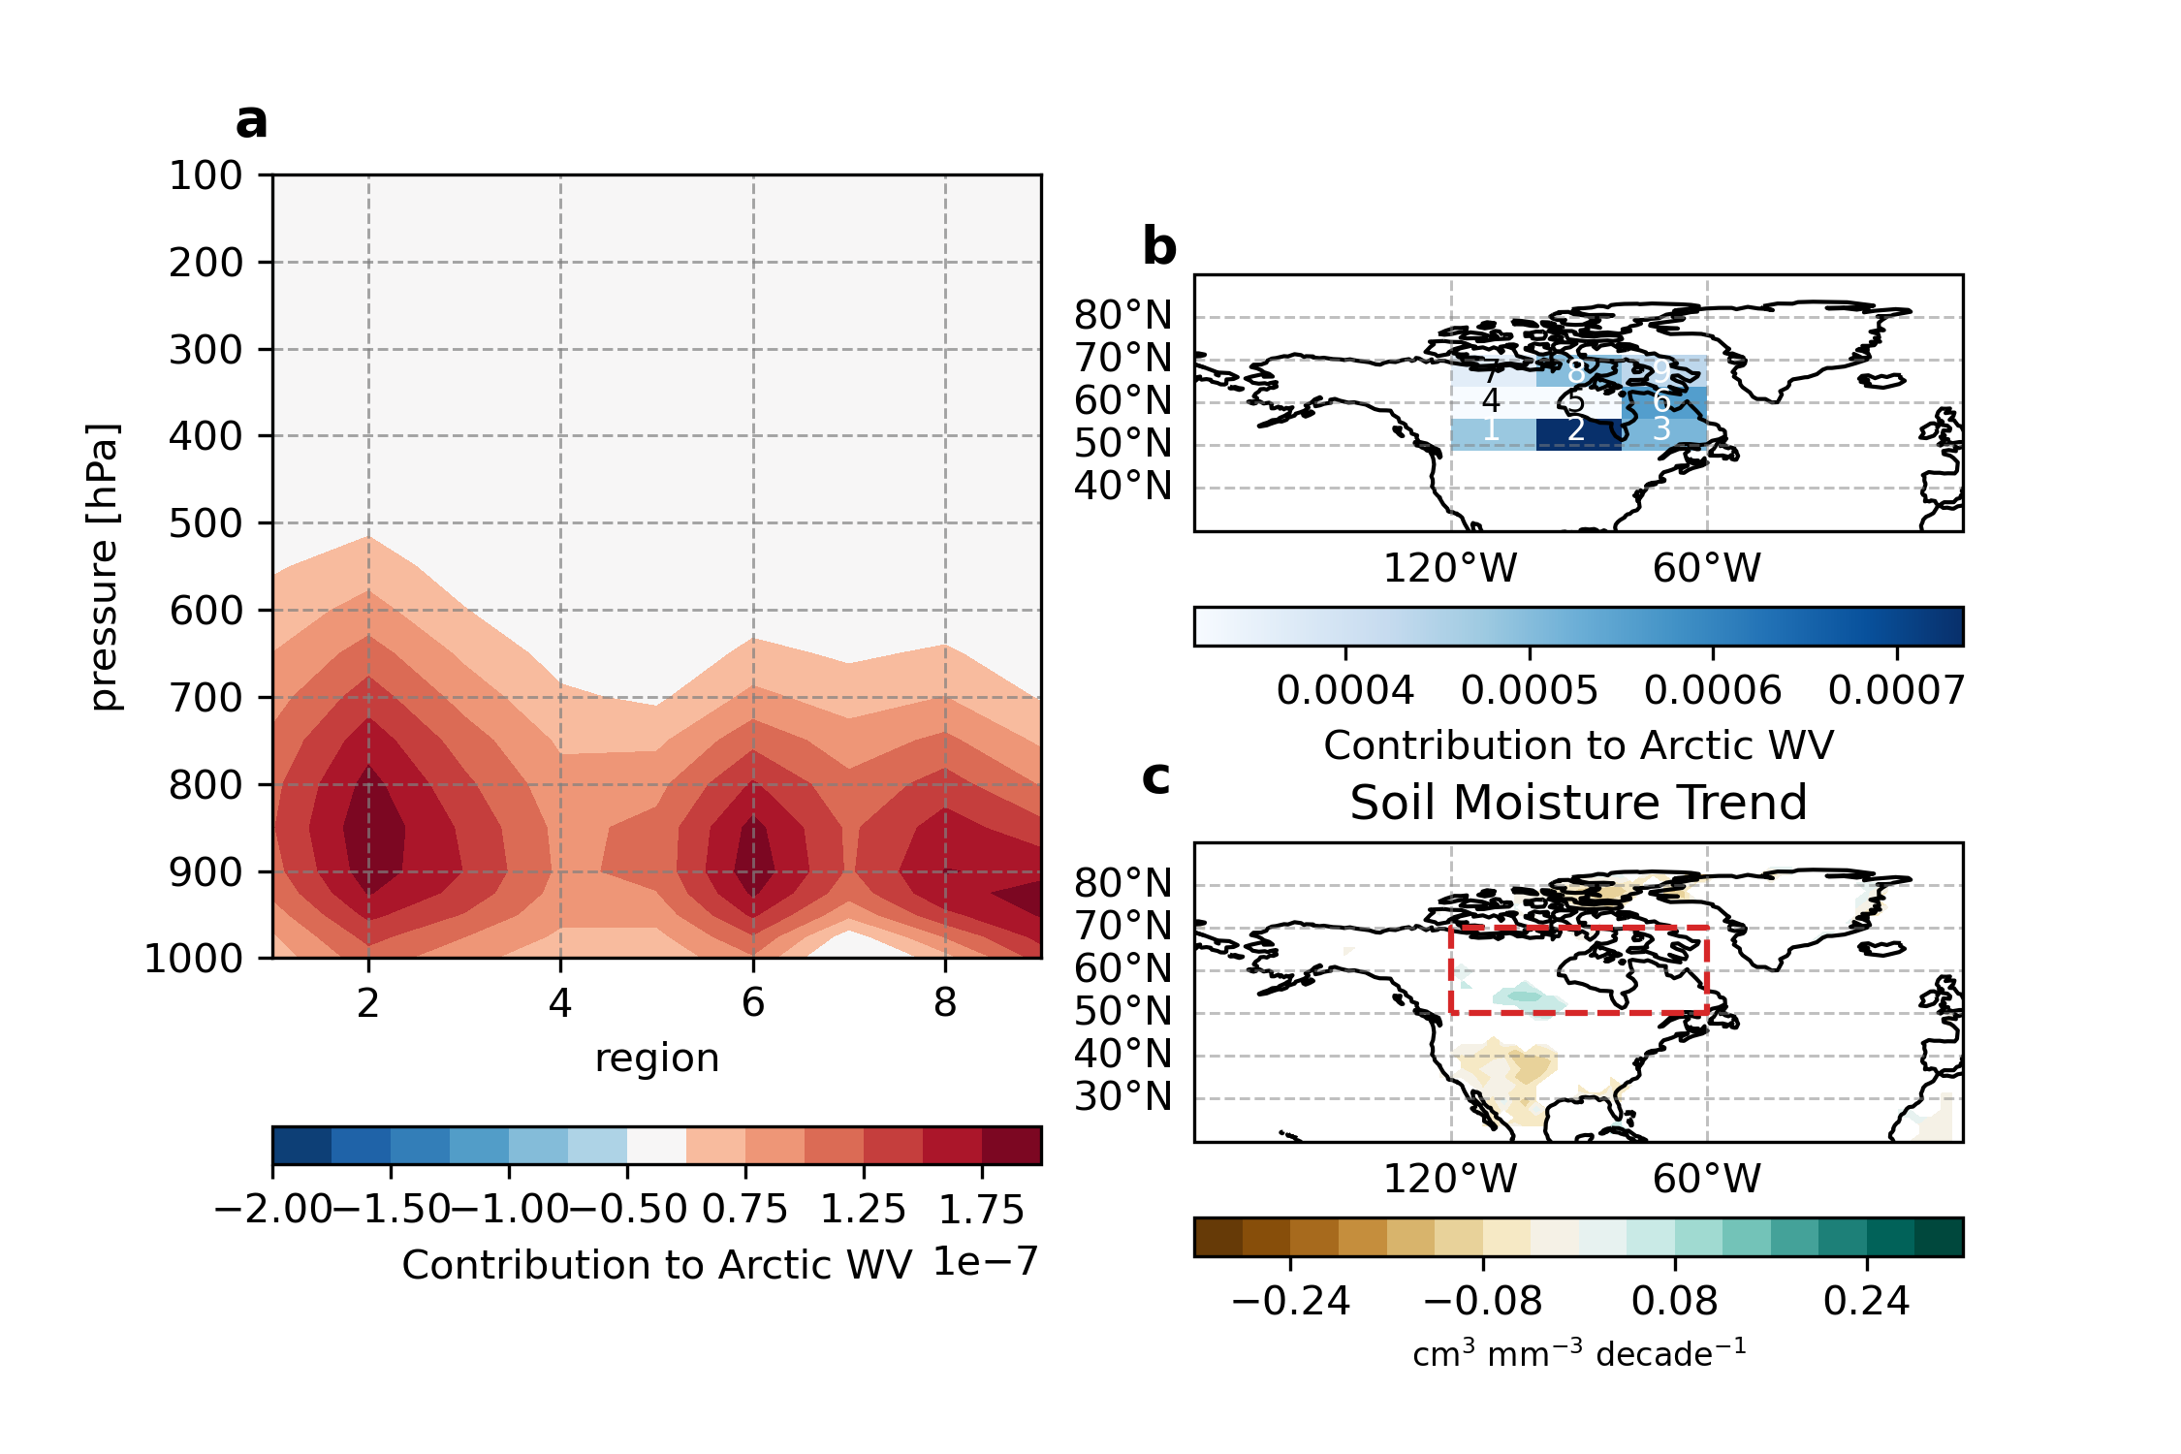

Slide 11
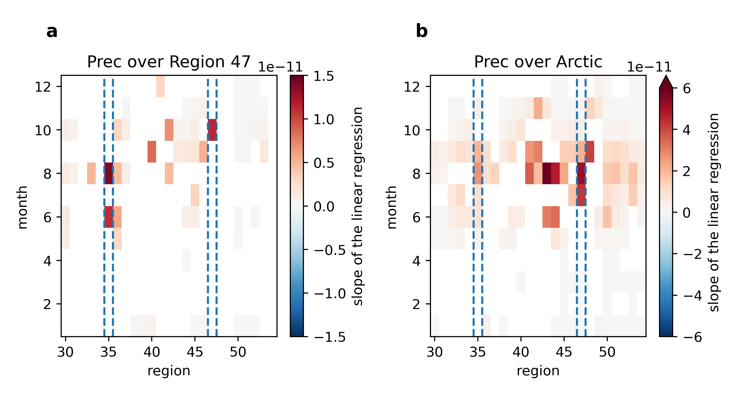

Slide 12
Summary
By nudging temperature and winds, we can replicate Arctic moisture and precipitation change from ERA5.
The model struggles to capture anticyclonic circulation over Greenland that diverts moisture transport west of the ice sheet
The North American pathway (AR-dominated) sourced from over land has the strongest contribution to summertime Arctic WV radiative effects.
Email: itbaxter@ucsb.edu

